Slide 1
Lecture 8:Graph Theory

Slide 2
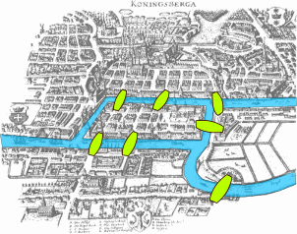
Seven Bridges of Konigsburg
The city of Königsberg was set on both sides of the Pregel River, and included two large islands which were connected to each other and the mainland by seven bridges.
Is there a walk through the city that would cross each bridge once and only once.
The islands could not be reached by any route other than the bridges, and every bridge must have been crossed completely every time

Slide 3
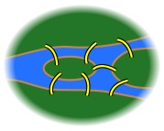
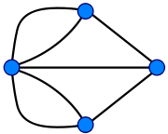
Can you draw the final figure without retracing the lines and not lifting the pencil from the paper ?
This is a GRAPH
Points: Vertices or Nodes
Lines: Edges or Links

Slide 4
Seven Bridges of Konigsburg
The Konigsburg bridge problem is one of the first problem to be solved using graph theory
Solved by Euler in 1735
Mathematically showed that such a walk cannot exist
For a solution to exist, no more than two vertices can have odd number of edges coming out of them. Why ?
Can you add or subtract a bridge to make the problem solvable ?

Slide 5
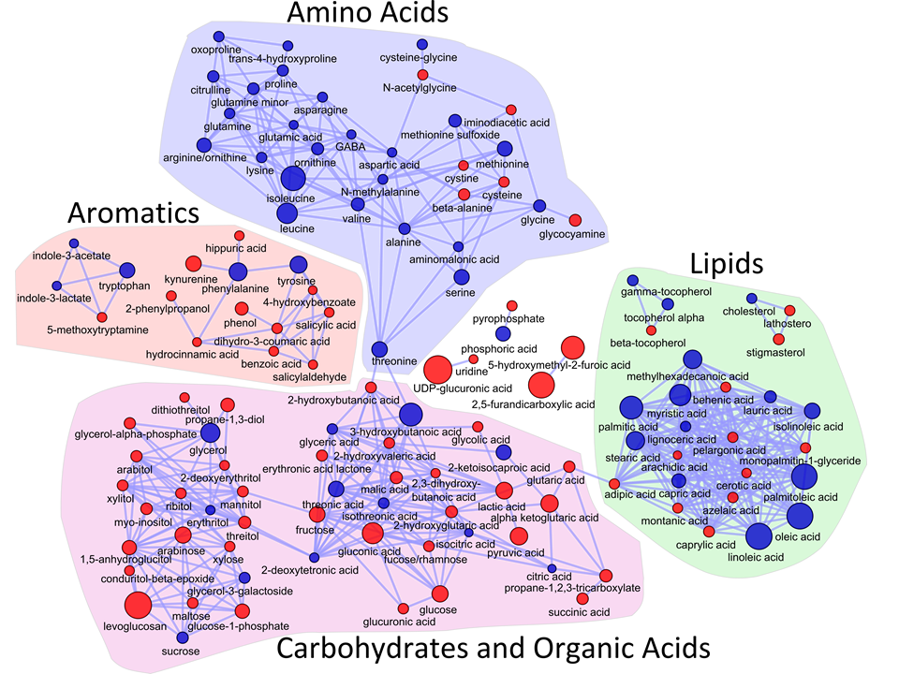

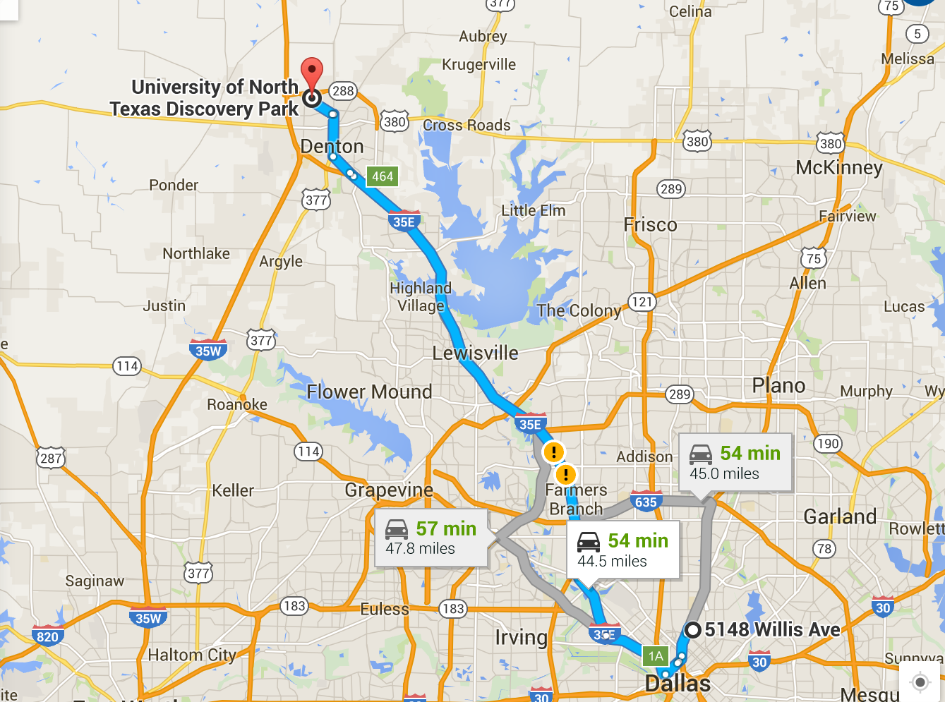
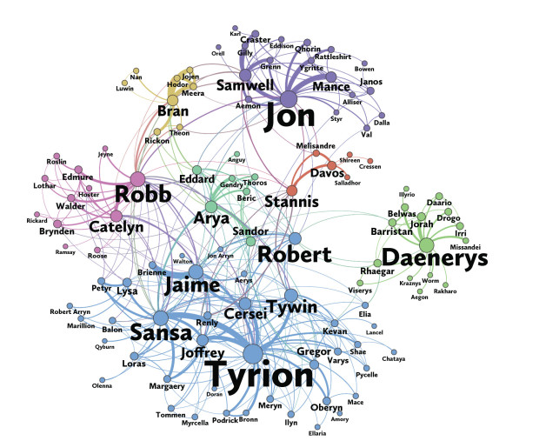
Examples

Slide 6
Properties of Graphs
Vertex Set={A,B,C,D,E}
Edge Set={ (A,B), (B,A), (B,C), (B,D),(C,B), (C,E), (C,F),(D,B),(D,E), (E,C),(E,D),(E,F), (F,C),(F,E)}
An undirected graph is a graph where if there is an edges (A,B) there will also be an edge (B,A)
Vertex v is a neighbor of vertex w if (v,w) is an edge in the list
C is a neighbor of B, but not of D
Degree of a vertex is its number of neighbors--Degree of C is 3
Degree distribution is the degree of the vertices in increasing order
1(A), 2(D), 2(F),3(B),3(C), 3(D)
A
B
C
F
D
E

Slide 7
Properties of Graphs
A
A path is a sequence of vertices (v1,v2, ..,vn), such that (v1, v2) is an edge
(A,B,C,E) is a path
(A,B,C,D) is NOT a path—just a sequence of vertices
The length of a path is the number of edges in the path
Length of path (A,B, C,E) is 3
A cycle is a path where the beginning and the end vertices are the same; v1=vn
(B,C,E,D,B) is a cycle of length 4
(C,E,F,C) is a cycle of length 3
B
C
F
D
E

Slide 8
Properties of Graphs
Vertex Set={A,B,C,D,E}
Edge Set={ (B,A), (B,C), (B,D), (C,E), (D,E), (D,F),(F,C)}
A directed graph is a graph where if there is an edges (A,B) there may NOT be an edge (B,A)
In-Degree of a vertex is the number of edges pointing to it. Vertex with only in-degrees is a sink
In-degree of C is 2
A is a sink
Out-Degree of a vertex is the number of edges going out from it
Vertex with only out-degrees is a source
Out-degree of C is 2
B is a source
A
B
C
F
D
E

Slide 9
Connectivity
A
A graph is connected if there is a path from every vertex to every other vertex
A directed graph is strongly connected if there is a path from every vertex to every other vertex while maintaining the direction of the edges
A directed graph is weakly connected if there is a path from every vertex to every other vertex while ignoring the direction of the edges
The directed graph (b) is weakly connected
The subgraph with purple nodes is strongly connected
B
C
F
D
E
(a) Undirected Graph
A
B
C
F
D
E
(b) Directed Graph

Slide 10
Definitions (Complete graph)
A complete graph is a graph in which there is an edge between every pair of vertices.
What is the total number of edges in a complete graph ?

Slide 11
Definitions (DAG)
A directed graph is acyclic if it has no cycles
DAG (directed acyclic graph)
V₂
V₁
V₃
V₄
Give an example of an acyclic graph
V₅

Slide 12
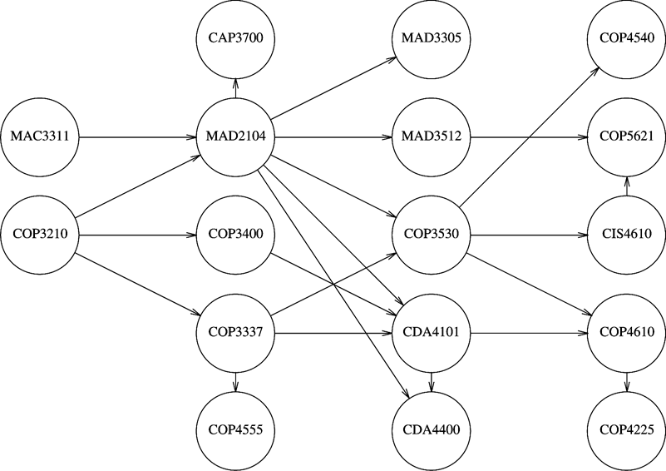


Topological Sort
Given a course prerequisite structure
Arrange the courses in a sequence such that it does not violate the prerequisite criteria.
An ordering of vertices in a directed acyclic graph such that if there is a path from V_{i} to V_{j} , then V_{j} appears after V_{i} in the ordering.
A topological ordering is not possible if the graph has a cycle.
The ordering is not necessarily unique.

Slide 13
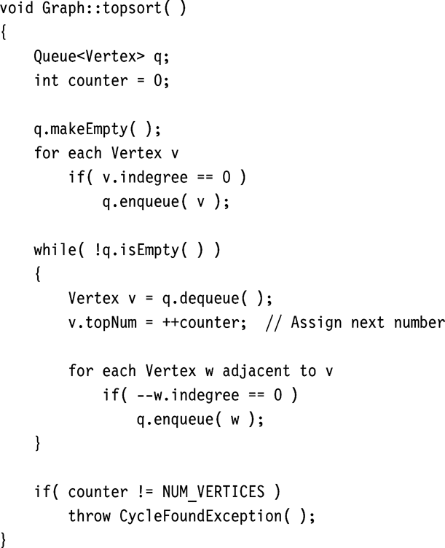
Pseudocode to perform topological sort
First, the indegree is computed for every vertex. Then all vertices of indegree 0 are placed on an initially empty queue.
While the queue is not empty, a vertex v is removed, and all vertices adjacent to v have their indegrees decremented.
A vertex is put on the queue as soon as its indegree falls to 0.
Complexity O( |E|+|V|)

Slide 14
Graph Traversal
B
A
B
C
A
D
C
F
E
F
D
E
Breadth First Search O(V+E)
1. Start at a vertex
2. Mark as visited
3. Visit all unvisited neighbors
4. Mark neighbors as visited
5. Stop when all nodes are visited

Slide 15
Graph Traversal
A
B
A
B
C
D
F
E
D
E
Depth First Search O(V+E)
1. Start at a vertex
2. Mark as visited
3. Visit any one of the unvisited neighbors
4. Mark the neighbor as visited
5. Continue until all vertices in a path are visited
6. Return to start with next unvisited vertex
7. Stop when all nodes are visited
F
C

Slide 16
Traversing Weighted Graphs
A
A
1
3
1
3
1
1
B
C
B
C
4
4
2
3
F
2
3
F
1
1
1
1
D
E
D
E
A graph is weighted if the edges have values associated with them
The single source shortest path (SSSP) problem considers the problem of
finding the shortest distance from a given vertex to all other vertices.
Solved by Dijkstra’s algorithm (Edsgar Dijkstra1956)
Similar to BFS, except we also visit previously visited nodes
And update the distance as needed

Slide 17
Single Source Shortest Path
With Negative Weights (Bellman-Ford)
Without Negative Weights (Djikstra)

Slide 18
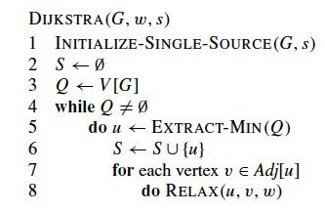
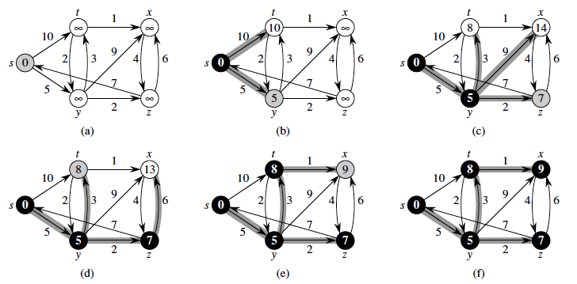
Dijkstra
Complexity O(V²+E) or O(VlogV+E) with better data structure

Slide 19
Graphs with Negative weights
In Dijkstra’s method once a node is extracted from the priority queue, it is not considered again.
Thus effect of negative weights not accounted
Bellman-Ford-Moore Algorithm (1958,1956,1959)
For each vertex (Step 1: Initialize)
Distance d[v]=INF; pred[v]=NULL
Repeat V-1 times (Step 2: Update repeatedly)
For each edge (u,v)
If d[v]>d[u]+weight(u,v)
d[v]=d[u]+weight(u,v) [update distance]
pred[v]=u;
For each edge (u,v) (Step 3: Check for negative cycle)
If d[v]>d[u]+weight(u,v)
Report negative cycle
Total complexity O(|V|+|V|*|E|)
Shortest distance A-B is (A-C-B)
Dijkstra’s algorithm will find 2 (A-B)
A
A
2
2
3
3
-6
C
B
-4
C
B
Negative Cycle
No Negative Cycle

Slide 20
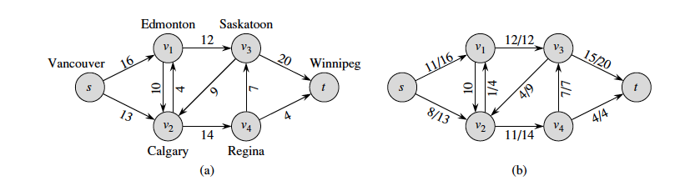
Max Flow Algorithm
How do we find the maximum flow through a set of pipes/routes, etc.

Slide 21
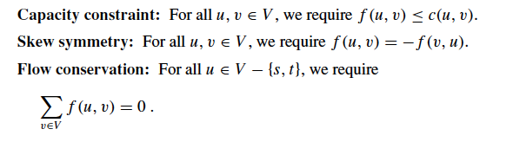
Flow Networks
A flow network is a directed graph where each edge has a non negative capacity
Follows the three properties;

Slide 22
Basic Algorithmic Step
Find a Path from Source to Sink
Depth First from Source until we hit Sink
Update the flow along the path
Remove the edges with 0 flow
Continue until there are no paths from Source to Sink

Slide 23
Example
S
S
S
3
2
3
2/2
2/3
1
1
1
A
B
A
B
A
B
4
2
4
2/2
4
3
3
2/3
C
D
C
D
C
D
2
3
2
2/3
2/2
1
T
T
T

Slide 24
Example -Continued
S
1/1
S
1
1
1
A
B
A
B
4
1/4
1
1
C
D
C
D
1
1/1
T
T
What is the problem with this algorithm ?
Maximum Flow 5

Slide 25
Problem
Not guaranteed to find maximum flow if we start from the wrong edge
Need provision to retrace our steps

Slide 26
Example
S
S
3
2
0
2
3
1
1
A
B
A
B
3
4
2
2
3
3
1
C
D
C
D
2
2
3
3
T
T

Slide 27
Ford-Fulkerson Algorithm
Find a Path from Source to Sink
Depth First from Source until we hit Sink
Update the flow along the path
Remove edges with 0 flow
Add edges in opposite direction for reverse flow
Continue until there are no paths from Source to Sink
Flow increases by at most 1 for each new path
Guaranteed to find maximum flow if the capacities are rational numbers
Execution time O(E *max_flow)

Slide 28
A Bad Example
S
100
100
A
B
1
100
100
T
If we always choose the edge (a,b) or (b,a) we will need 100 steps to terminate

Slide 29
Modification
Always choose the augmenting path that allows largest increase to flow.
Like weighted shortest-paths (other way round)
Modification of Dijkstra’s algorithm (Breadth First)
Edmond’s-Karp Algorithm

Slide 30
Biconnected Graphs
A connected undirected graph is biconnected if there are no vertices whose removal disconnects the rest of the graph
Vertices whose removal disconnects graphs are known as articulation points
Used in detecting crucial points in networks

Slide 31
Example
B
A
C
D
F
G
E

Slide 32
Finding Articulation Point
Do a depth First Traversal of the Graph
Create a tree with directed edges showing order of traversal
Set Num(v)=the order in which graphs are visted
Add remaining edges to the tree as back edges
Set Low(v) as the lowest vertex that can be reached using tree edges and at most one back edge
If for any vertex (other than root) v with child w Low(w) >= Num(v) , then v is an articulation point
If root has more than one child root is an articulation point

Slide 33
Example
2/1
B
A
1/1
6/4
4/1
3/1
C
D
F
7/7
G
E
5/4

